Slide 1
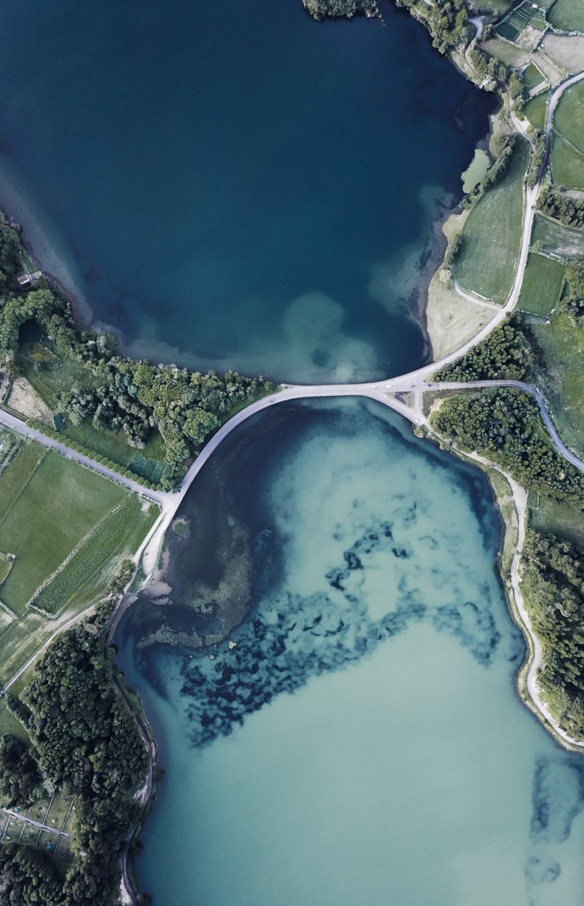

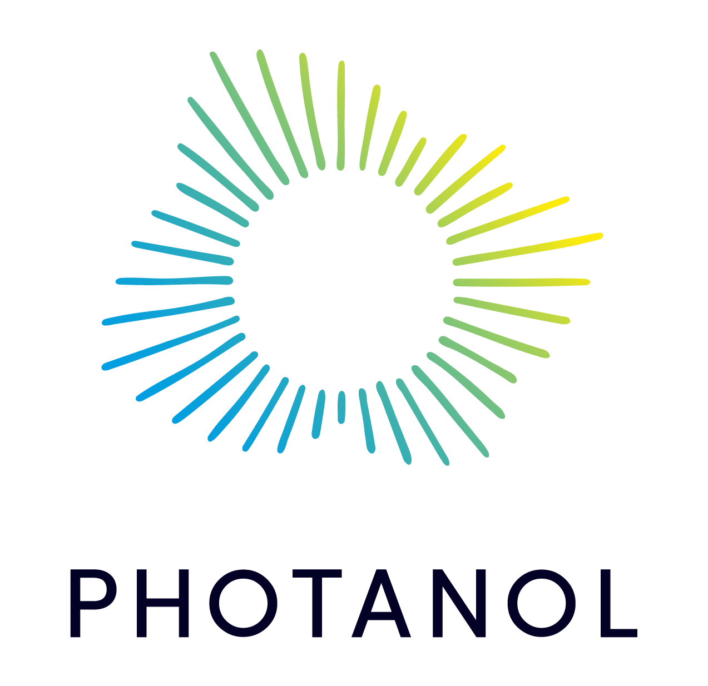
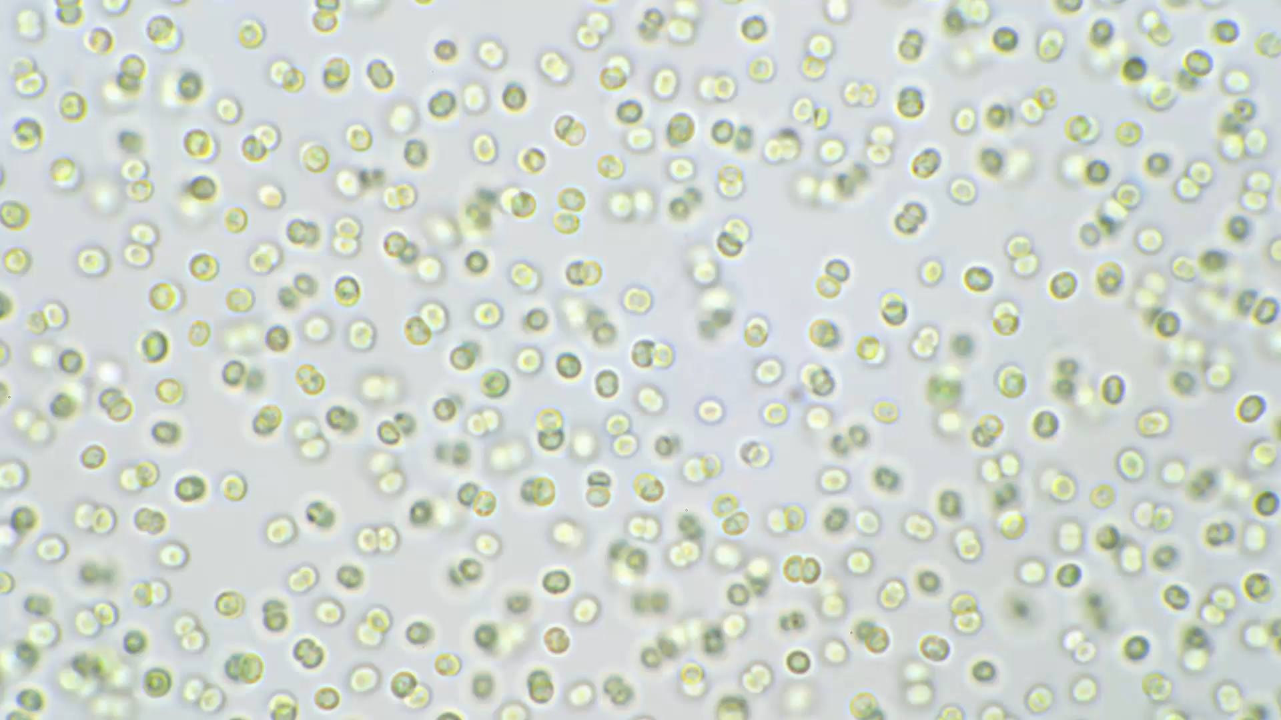
Applying Design of Experiments and Machine Learning algorithms to define the consumption envelope of lactic acid
Marc Garcia Lopez
Photanol - Universitat Oberta de Catalunya
2022-2023

Slide 2
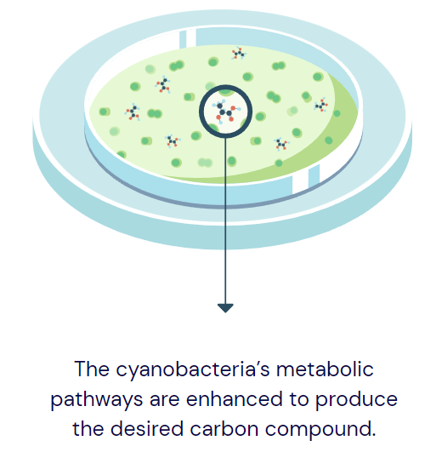
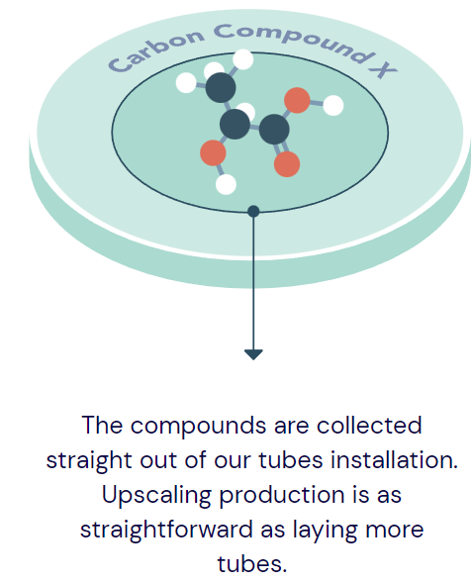
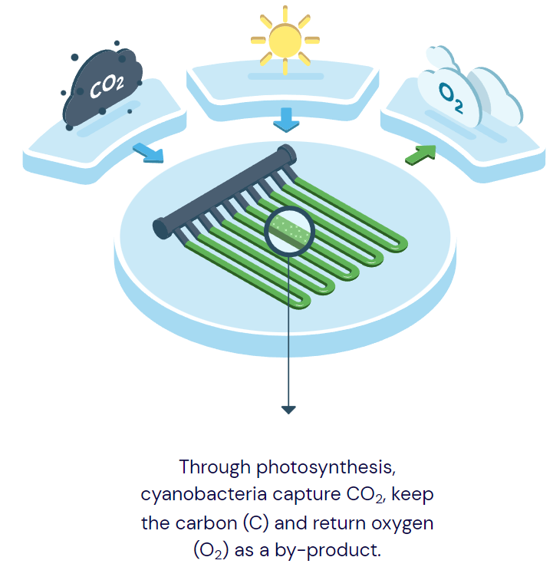
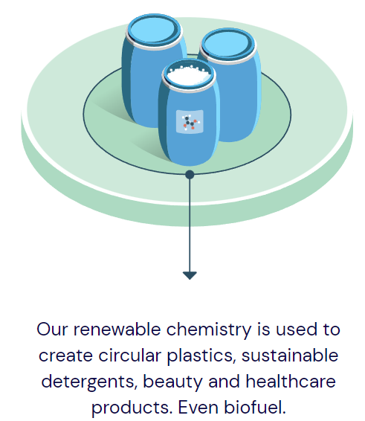
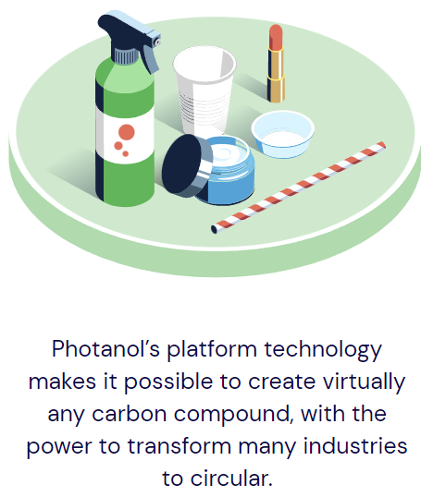
Photanol’s approach
Photanol
Confidential

Slide 3
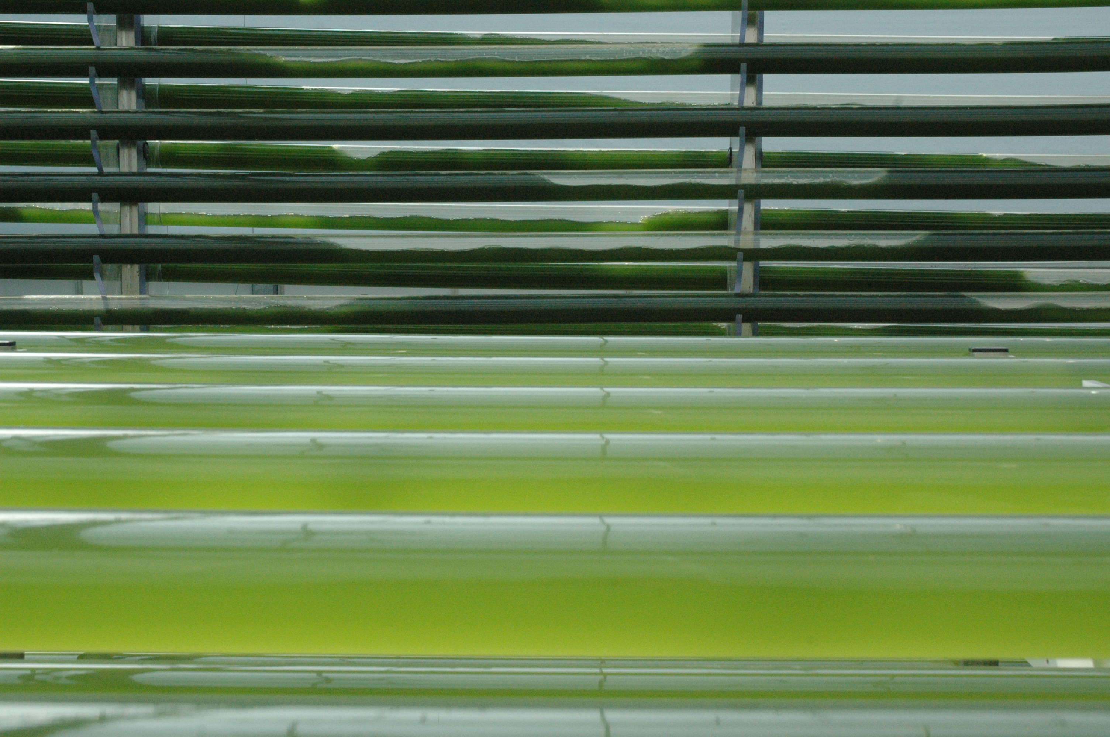
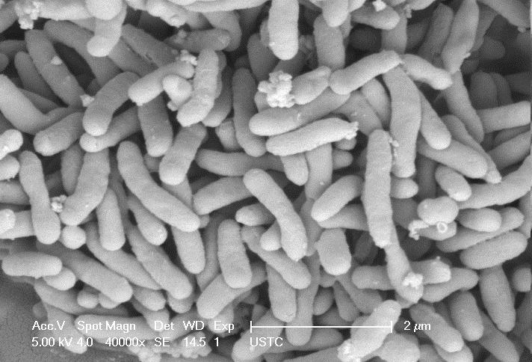
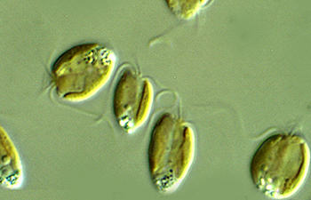
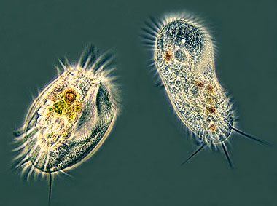
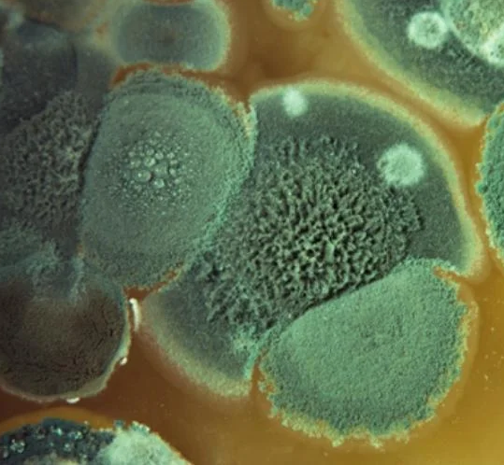
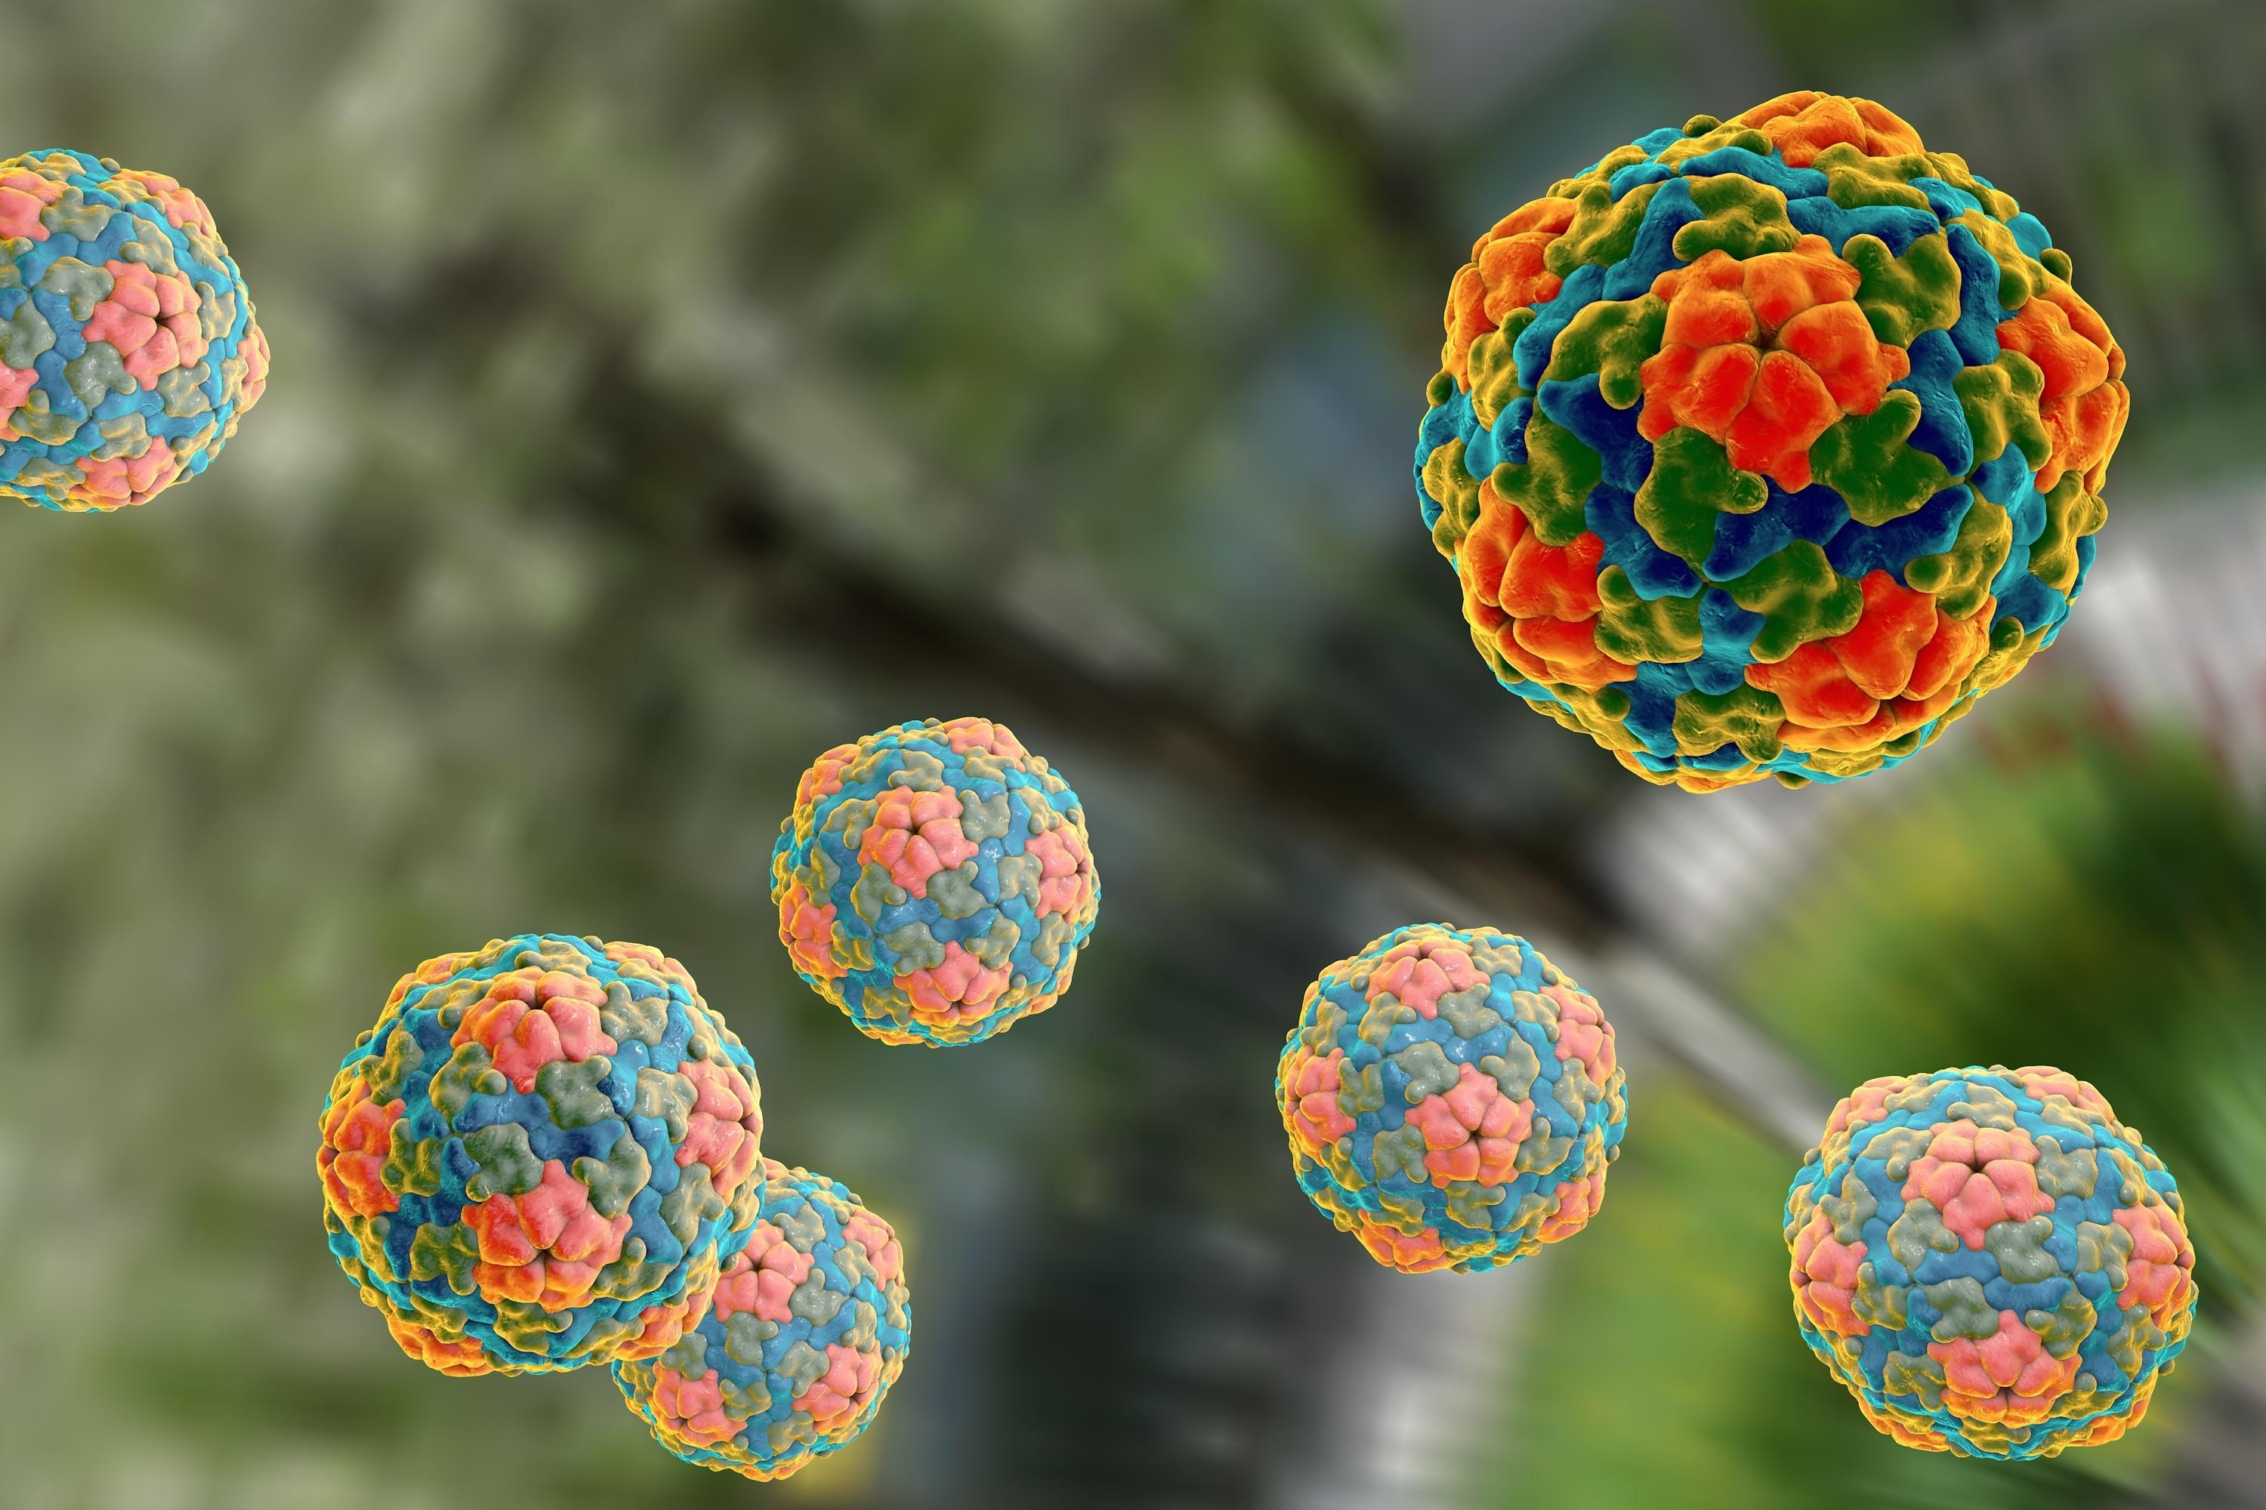
The problem
Other algae
Zooplankton
Product consuming bacteria
Fungi
Viruses
Compete for nutrients
Consume the bio-products (SMP)
Sudden crashes
PBR contaminated with biological pollutants
Confidential

Slide 4
Goal
Safe consumption envelope
Strain envelope
Industrial envelope
Find those combinations of temperature (T), pH and osmolarity (π) that inactivate the biological pollutants and, therefore, prevent the consumption of lactate in our PBRs (β < 0.1 mM/day).
Safe consumption envelope
Industrial envelope: boundaries of our industrial process.
Strain envelope: physiological limits of cyanobacterial strains.
Photanol
Confidential

Slide 5

Objectives
Main objectives:
Specific objectives:
Definition of the safe lactate consumption envelope.
β ≤ 0.1 mM/day.
Construction of classifiers based on ML algorithms that are capable of discerning between safe and not safe experiments.
Contextualization of the problem and definition of a proper experimental design.
Descriptive analysis of the data (EDA).
Construction of an array of classifiers based on the following ML algorithms: NB, RF, ANN, SVM.
Assessing the performance and hyperparameter optimization.
Selection of the best algorithms.
Making predictions, identification of patterns and visualization of the predictions.
Validation of the classifiers and update.

Slide 6
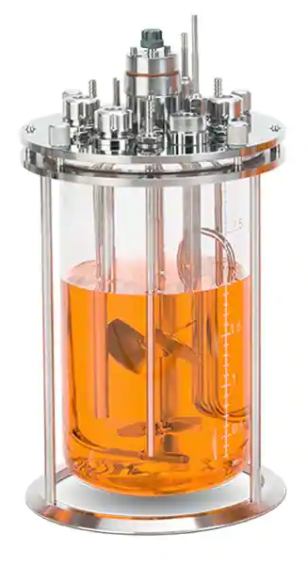
Materials & methods (2)
Data gathering:
Data modelling:
Exploratory Data Analysis (EDA)
Selection of the adequate method
Construction of the first classifiers
pH, T, π
Hyperparameter optimization
Selection of the best classifiers
Making and visualizing predictions
lactate conc
qvcd
β (avg qvcd)
Validations
Updating the models
Synechocystis + contaminants
pH | T [˚C] | π [M NaCl] | β [mM lactate/day]
10.5 | 30 | 0.3 | 20.18
… | … | … | …
11.5 | 50 | 1 | 0

Slide 7
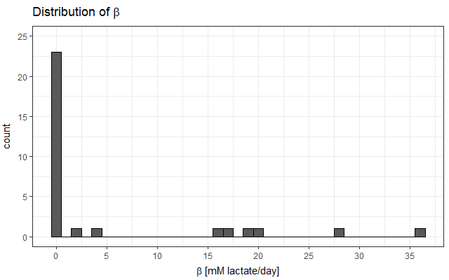
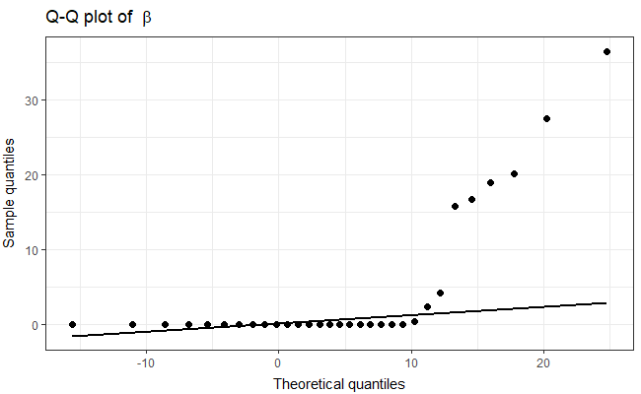
Exploratory data analysis
Data non-normally distributed.
Shapiro Wilk: 1.5e-08, Anderson-Darling: 2.6e-16, Kolmogorov-Smirnov: 5.3e-05.
Zero-inflated data.
Dichotomization
Safe (β ≤ 0.1 mM/day)
Not Safe (β 0.1 > mM/day)

Slide 8
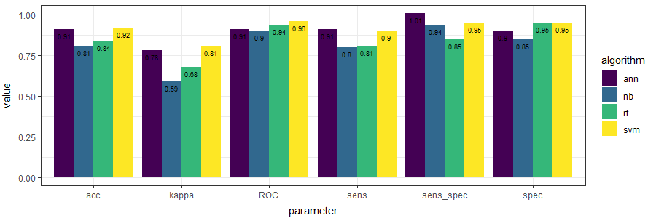
Selecting the best algorithm
The best classifier was the SVM, followed closely by the ANN.
The worst classifier was the NB.

Slide 9
Predictions over specific conditions
pH | T [˚C] | π [mM NaCl] | Prediction (SVM) | Prediction (ANN) | Actual value
9 | 55 | 0.3 | Safe (100%) | Safe (100%) | -
11.5 | 30 | 1 | Safe (100%) | Safe (100%) | Safe
9.5 | 38 | 1 | Safe (100%) | Safe (100%) | -
9.75 | 47 | 0.3 | Safe (100%) | Safe (100%) | -
11 | 35 | 0.4 | Not safe (100%) | Safe (100%) | -
10.2 | 46 | 0.3 | Safe (100%) | Safe (100%) | -
9 | 30 | 0.3 | Not safe (100%) | Not safe (100%) | -
9 | 45 | 0.3 | Not safe (100%) | Not safe (100%) | Not safe
9.5 | 45 | 0.3 | Not safe (100%) | Not safe (100%) | -
10 | 45 | 0.3 | Safe (100%) | Safe (100%) | Safe
9 | 42 | 0.6 | Not safe (100%) | Not safe (100%) | -
Tool provided to the Chassis team.
11 predictions carried out and contrasted.
Each prediction was repeated 1.1 x 10⁶ times. Consistent outcome.
SVM and ANN agreed on 10/11 predictions.
SVM and ANN successfully predicted 3/3 of the already tested conditions.

Slide 10
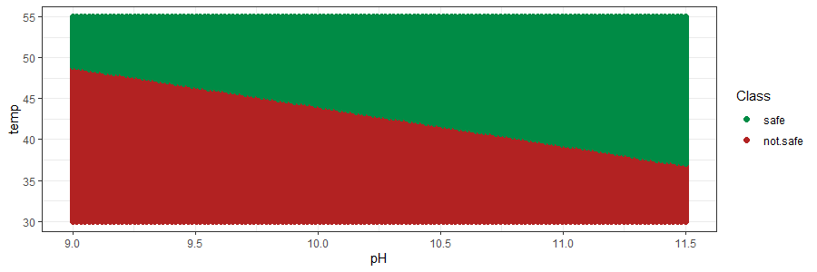
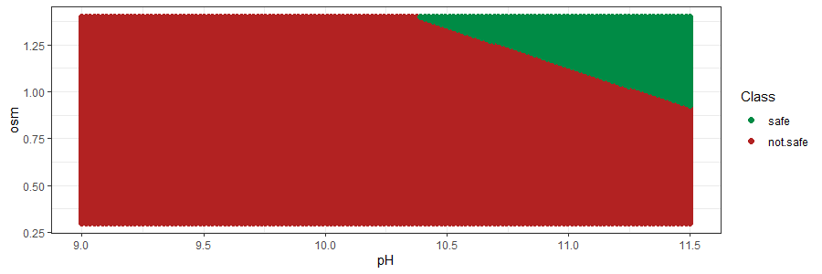

Visualizing the lactate consumption envelope (SVM)
all predictions; safe predictions; not safe predictions
When π = 0.3 M NaCl:
Approximately, half of the predictions were safe.
And pH ≈ 9, T needs to be ≥ 48 ˚C.
And pH ≈ 10, T needs to be almost 45 ˚C.
And pH ≈ 11, T needs to be ≥ 40 ˚C.
When T = 30 ˚C:
Most predictions were unsafe.
And pH = 10.5, π has to be ≥ 1.3 M NaCl.
And pH = 11, π needs to be ≥ 1.1 M NaCl.
And pH = 11.5, π needs to be ≥ 0.9 M NaCl.
When pH = 9:
Again, approximately half of the predictions are safe.
As mentioned before, when π = 0.3 M NaCl, T has to be ≥ 48 ˚C.
When π = 1 M NaCl, T needs to be ≥ 42 ˚C.
When π = 1.25 M NaCl, T has to be ≥ 38 ˚C.

Slide 11
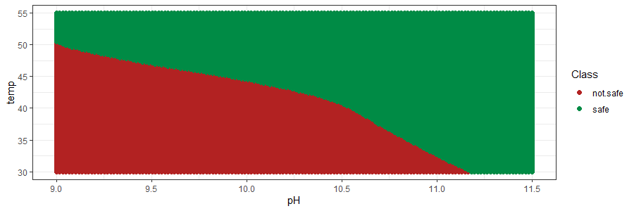
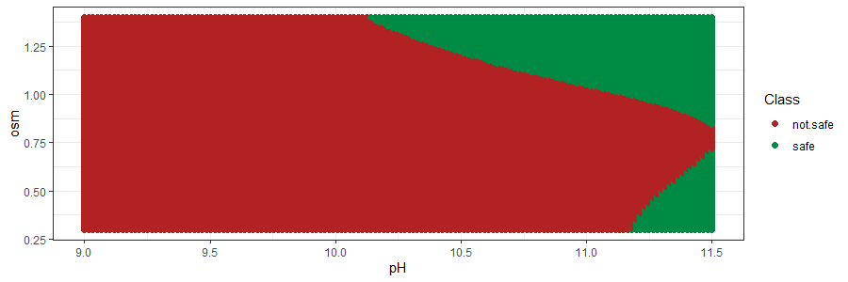
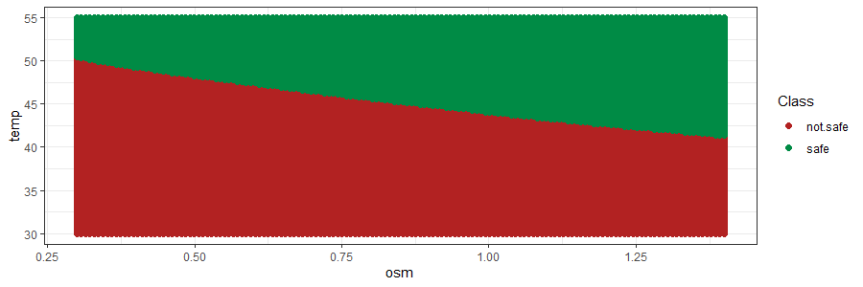
Visualizing the lactate consumption envelope (ANN)
all predictions; safe predictions; not safe predictions
Consumption envelope slightly different to what we obtained with the SVM.
More curvy boundaries.
When π = 0.3 M NaCl, regardless of the temperature, all conditions with pH ≥ 11.25 were predicted as safe.
When T = 30 ˚C, more conditions were predicted as safe, including some at pH ≥ 11.25 and low osmolarity.
When pH = 9, less conditions were predicted as safe.

Slide 12
Validating the lactate consumption envelope
pH | T [˚C] | π [mM NaCl] | Prediction (SVM) | Prediction (ANN) | Actual value
9 | 45 | 0.3 | Not safe (100%) | Not safe (100%) | Not safe
9.5 | 45 | 0.3 | Not safe (100%) | Not safe (100%) | Not safe
10 | 45 | 0.3 | Safe (100%) | Safe (100%) | Safe
9 | 42 | 0.6 | Not safe (100%) | Not safe (100%) | Not safe
4 validations carried out and contrasted.
Each prediction was repeated 1100000 times. The outcome was robust and constant.
SVM and ANN-classifiers agreed on all the predictions.
All the predictions matched with the actual outcome.
Reliable classifiers

Slide 13
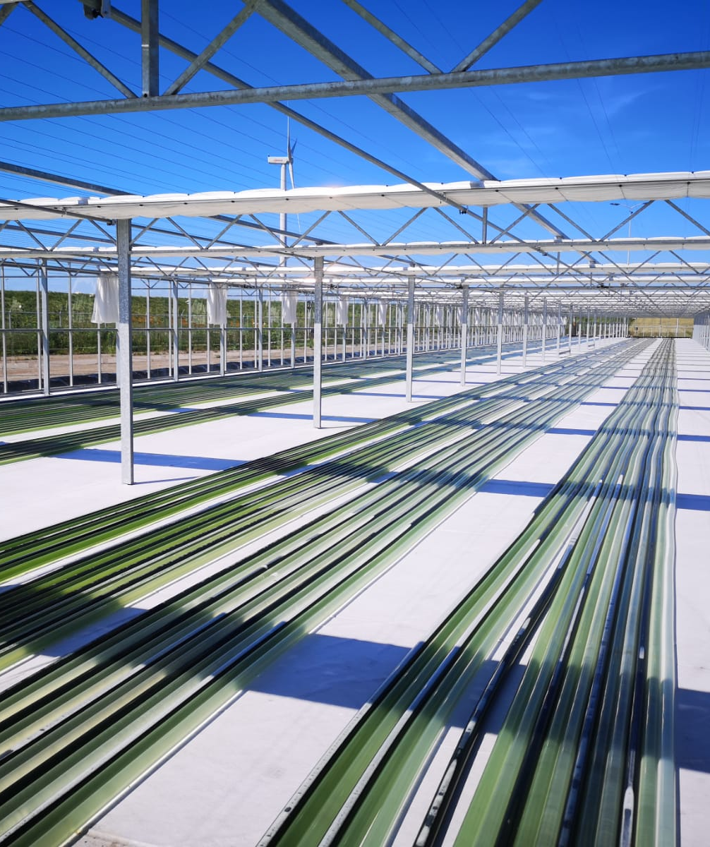
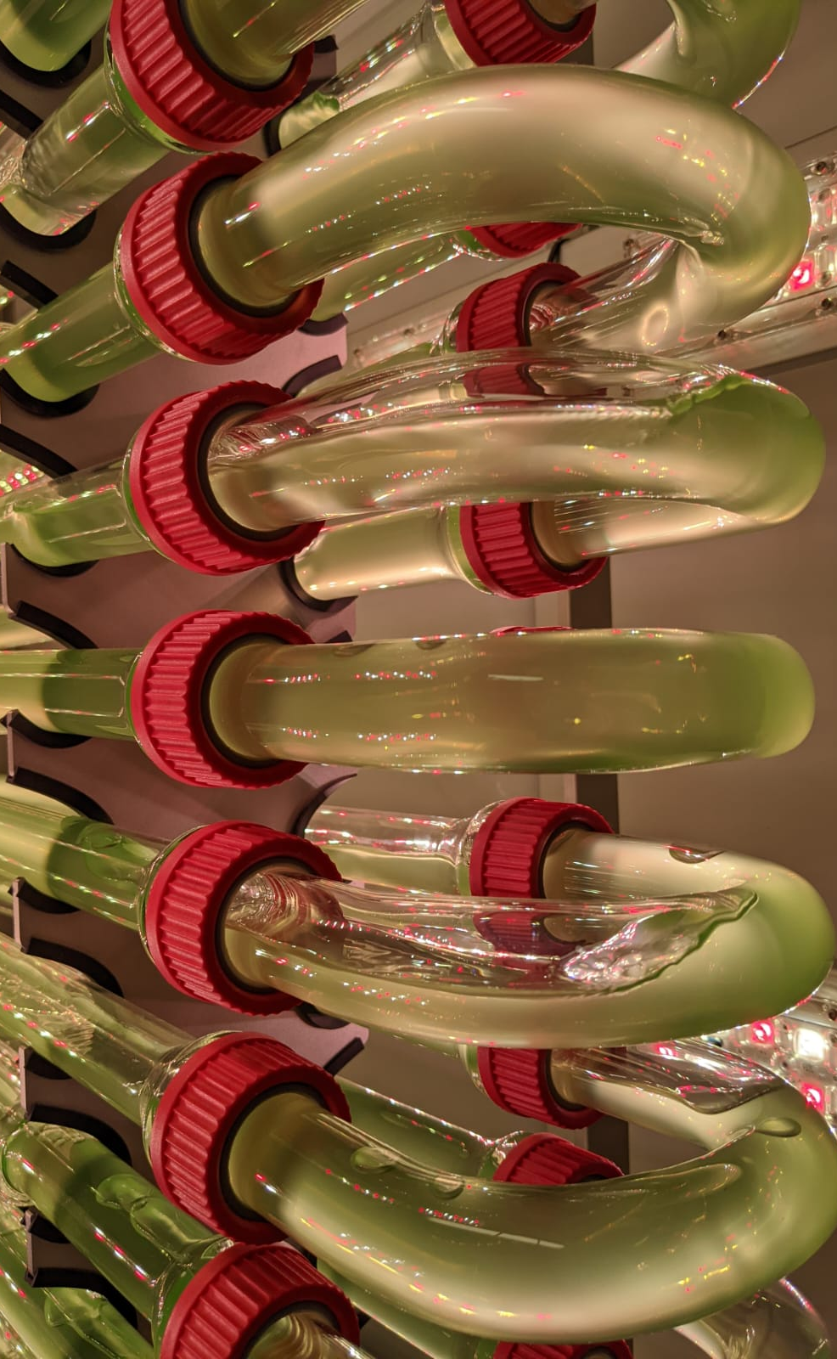
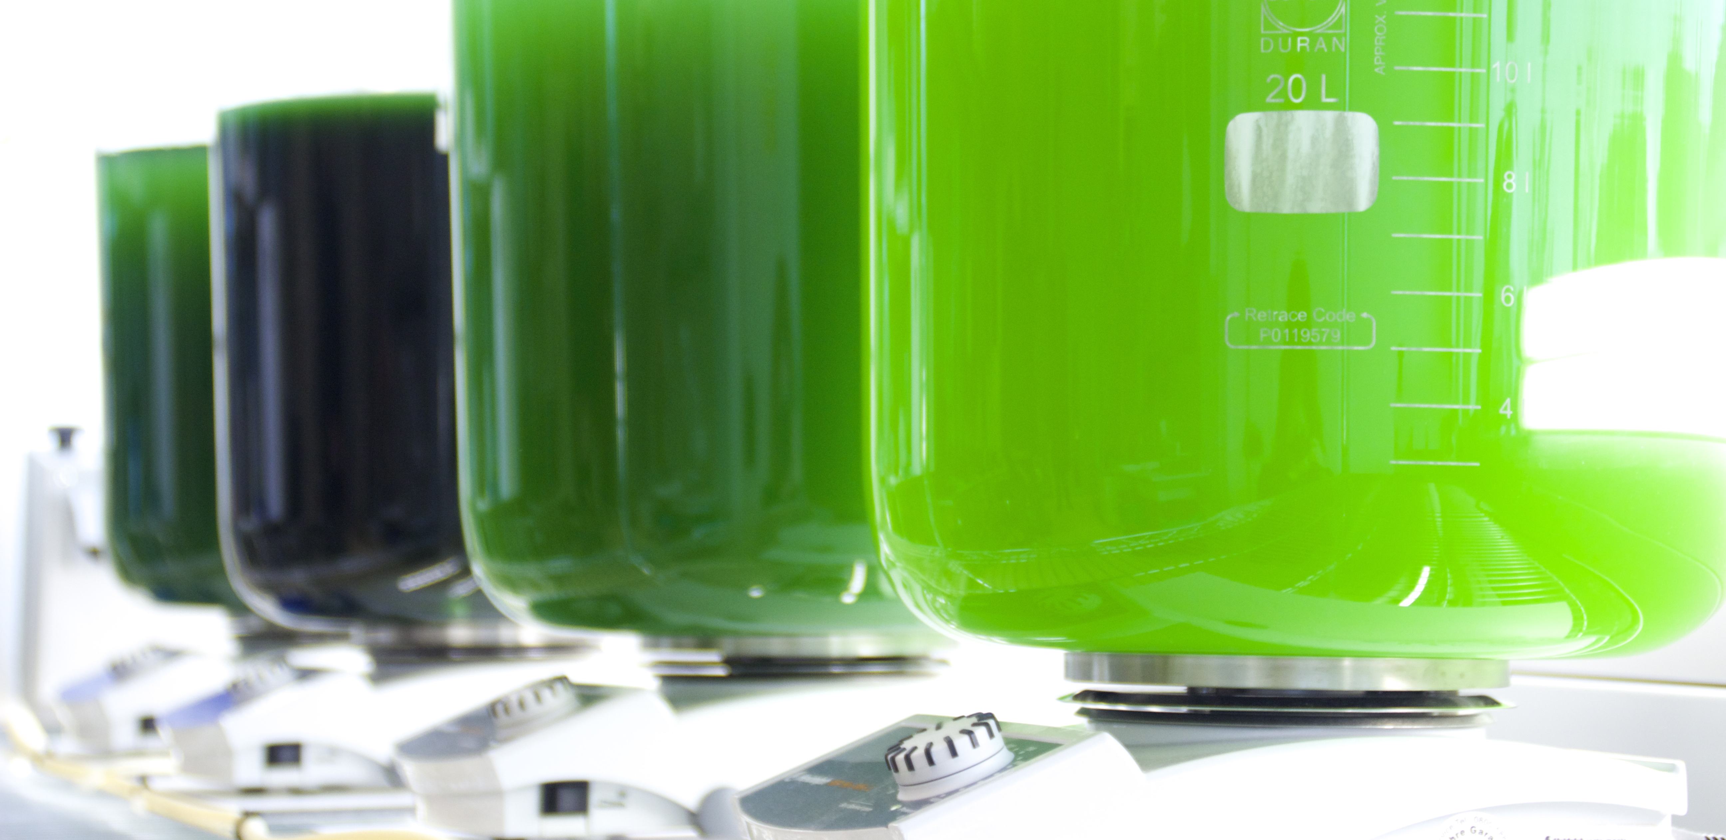
Conclusions
The best algorithm was the SVM, followed closely by the ANN.
The selected classifiers have been successfully used to:
Make predictions over specific conditions.
Map the lactate consumption envelope.
Temperature plays the most important role, followed by pH and, finally, osmolarity.
The classifiers have been validated.
4/4 predictions were correct.
Confidential

Slide 14
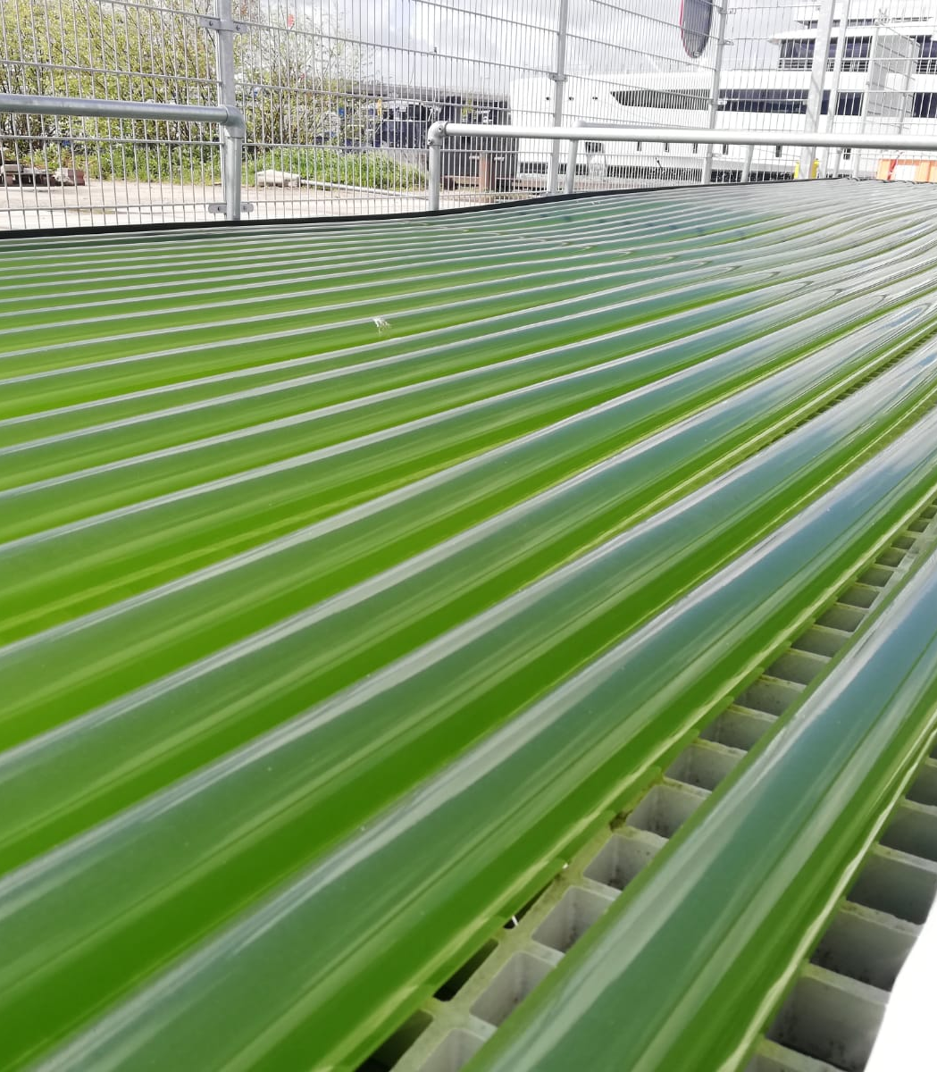
Further steps
Carry out more validations in order to increase the reliability of the classifiers and to increase the robustness of the lactate consumption envelope.
Cross the safe lactate consumption envelope with the strain envelope and the industrial envelope in order to define the operational envelope.
Define the consumption and operational envelope for glycolate.
Confidential

Slide 15
Thank you!
marc.garcialopez@photanol.com
https://photanol.com/

